Slide 1
DC Circuits
Nodal Voltage Method
By Dr. Ahmed S. Abdullah
د. احمد سليمان عبدالله

Slide 2
Nodal Voltage Method
Nodal voltage analysis applies KCL to find unknown voltages.
A node is the point of connection between two or more branches.
The nodal voltage method is applied as follows:
Step 1 : Convert each voltage source in the network to its equivalent current source.
Step 2 : Determine the number of nodes within the network.
Step 3 : Pick a reference node, and label each remaining node with a subscripted value of voltage: V1, V2, and so on.
Step 4 : Apply Kirchhoff’s current law at each node except the reference.
Step 5 : Solve the resulting equations to obtain the unknown node voltages.

Slide 3
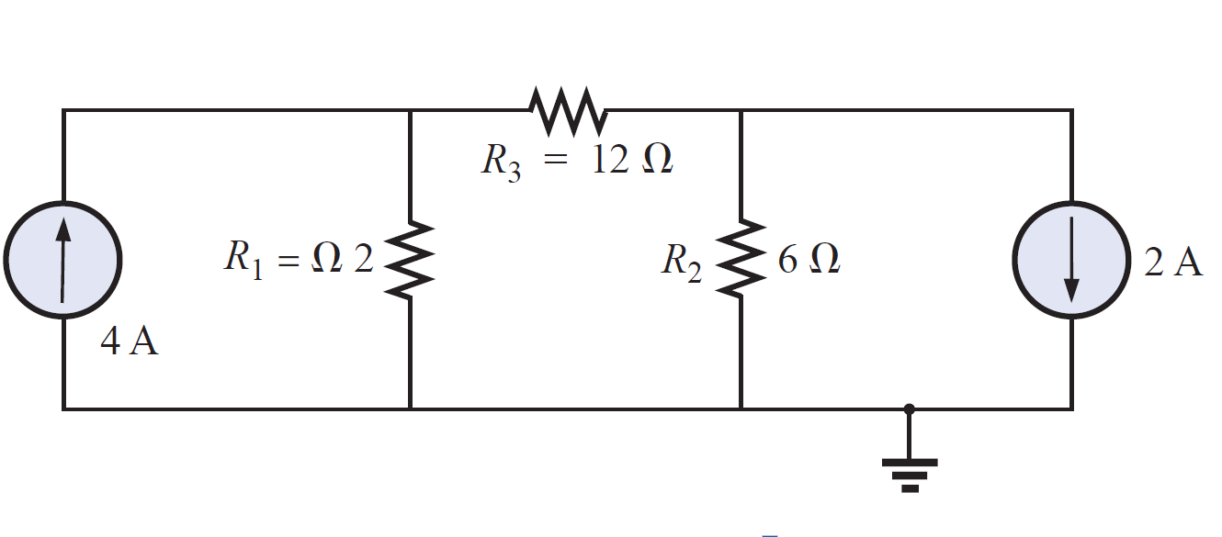
Nodal Voltage Method
EXAMPLE: Using the nodal voltage method, determine the currents in R₁, R₂ and R₃, in the circuit shown.

Slide 4
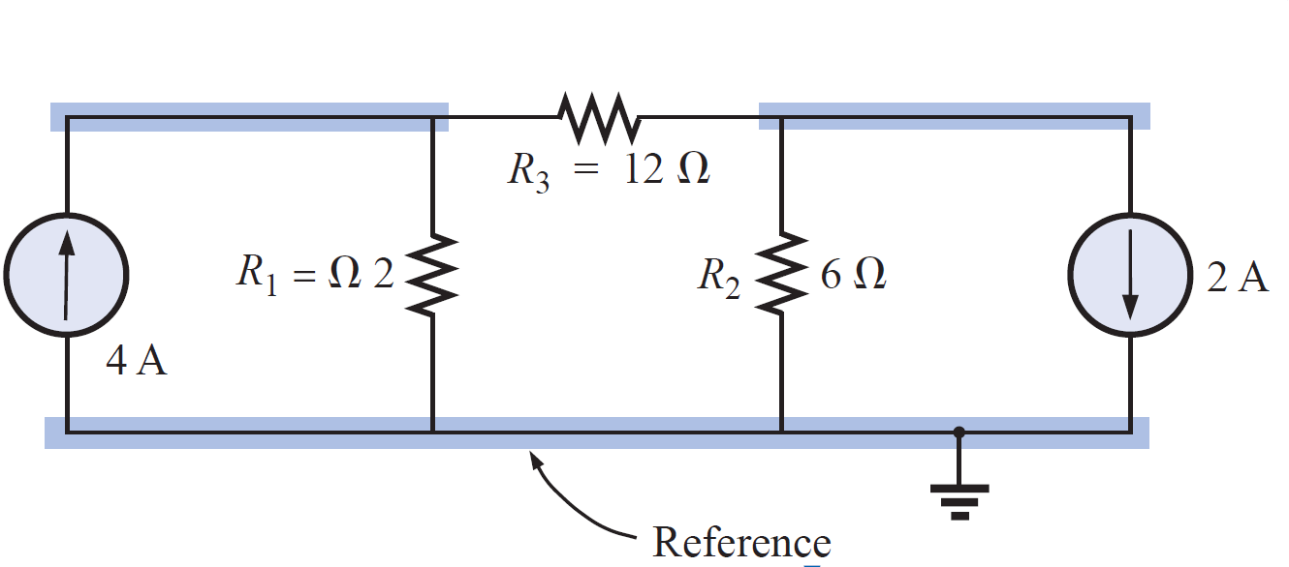
Nodal Voltage Method
EXAMPLE: Using the nodal voltage method, determine the currents in R₁, R₂ and R₃, in the circuit shown.
Solution:
Step 2 : Determine the number of nodes within the network.

Slide 5
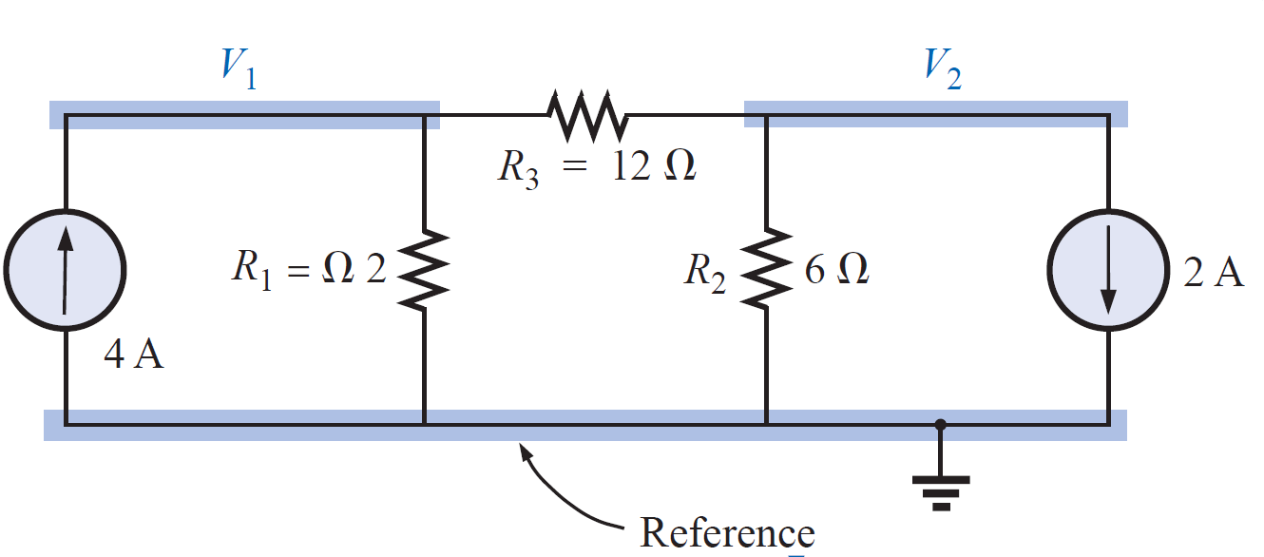
Nodal Voltage Method
EXAMPLE: Using the nodal voltage method, determine the currents in R₁, R₂ and R₃, in the circuit shown.
Solution:
Step 3 : Pick a reference node, and label each remaining node with a subscripted value of voltage: V1, V2, and so on.

Slide 6
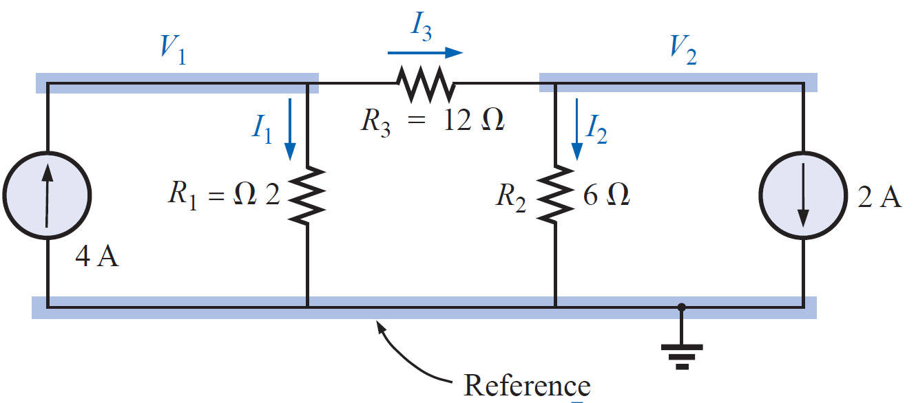
Nodal Voltage Method
EXAMPLE: Using the nodal voltage method, determine the currents in R₁, R₂ and R₃, in the circuit shown.
Solution:
Step 4 : Apply Kirchhoff’s current law at each node except the reference.

Slide 7
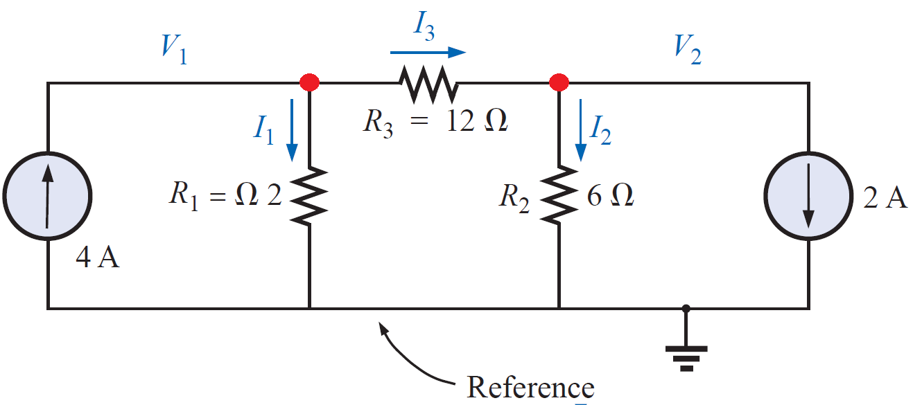
Nodal Voltage Method
EXAMPLE: Using the nodal voltage method, determine the currents in R₁, R₂ and R₃, in the circuit shown.
Solution:
Step 4 : Apply Kirchhoff’s current law at each node except the reference.
For node 1 :
Applying Kirchhoff’s current law:

Slide 8
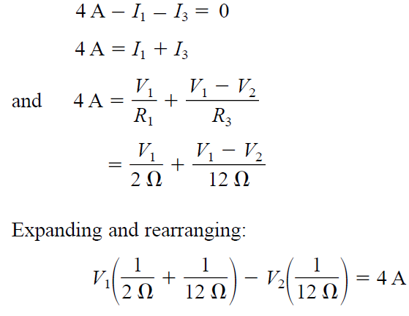
Nodal Voltage Method
EXAMPLE: Using the nodal voltage method, determine the currents in R₁, R₂ and R₃, in the circuit shown.
Solution:
Step 4 : Apply Kirchhoff’s current law at each node except the reference.
For node 1 :
Applying Kirchhoff’s current law:

Slide 9
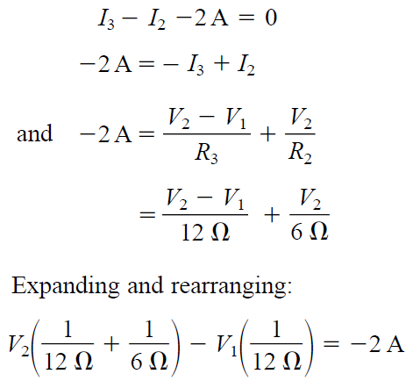
Nodal Voltage Method
EXAMPLE: Using the nodal voltage method, determine the currents in R₁, R₂ and R₃, in the circuit shown.
Solution:
Step 4 : Apply Kirchhoff’s current law at each node except the reference.
For node 2 :
Applying Kirchhoff’s current law:

Slide 10
Nodal Voltage Method
EXAMPLE: Using the nodal voltage method, determine the currents in R₁, R₂ and R₃, in the circuit shown.
Solution:
Step 5 : Solve the resulting equations to obtain the unknown node voltages.
producing

Slide 11
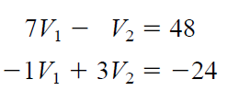
Nodal Voltage Method
EXAMPLE: Using the nodal voltage method, determine the currents in R₁, R₂ and R₃, in the circuit shown.
Solution:
Step 5 : Solve the resulting equations to obtain the unknown node voltages.
$$∆ =\left|\begin{matrix}+7 & −1 \\ −1 & +3\end{matrix}\right|=\left(7)(3\right)−\left(−1\right)\left(−1\right)=21−1=+20$$
$$∆1=\left|\begin{matrix}+48 & −1 \\ −24 & +3\end{matrix}\right|=\left(48)(3\right)−\left(−1\right)\left(−24\right)=144−24=120$$
$$∆2=\left|\begin{matrix}+7 & +48 \\ −1 & −24\end{matrix}\right|=\left(7)(−24\right)−\left(48\right)\left(−1\right)=−168+48=−120$$
$$∴V_{1}=\frac{∆1}{∆}=\frac{120}{+20}=+6 V$$
$$and V_{2}=\frac{∆2}{∆}=\frac{−120}{+20}=−6 V$$

Slide 12
Nodal Voltage Method
EXAMPLE: Using the nodal voltage method, determine the currents in R₁, R₂ and R₃, in the circuit shown.
Solution:
Step 5 : Solve the resulting equations to obtain the unknown node voltages.
$$∴V_{1}=+6 V$$
$$and V_{2}=−6 V$$
$${I_{R1}=I}_{1}=\frac{V_{1}}{R_{1}}=\frac{+6}{+2}=+3 A$$
$${I_{R2}=I}_{2}=\frac{V_{2}}{R_{2}}=\frac{−6}{+6}=−1 A$$
The minus signs indicate that the current has opposite direction
Since V1 is greater than V2, the current through R3 passes from V1 to V2.
Its value is
$${I_{R3}=I}_{3}=\frac{{V_{1}−V}_{2}}{R_{3}}=\frac{+6−(−6)}{+12}=\frac{+12}{+12}=+1 A$$

Slide 13
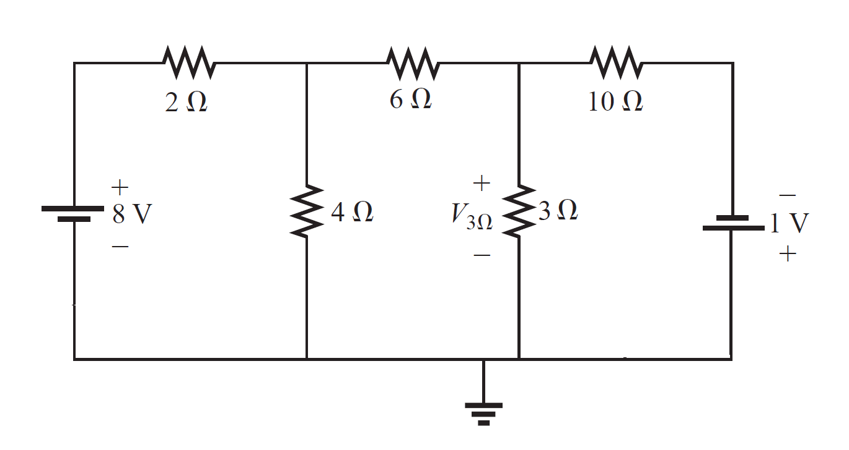
Nodal Voltage Method
EXAMPLE: By using nodal voltage method, find the voltage across the 3 Ω resistor of the circuit shown.

Slide 14
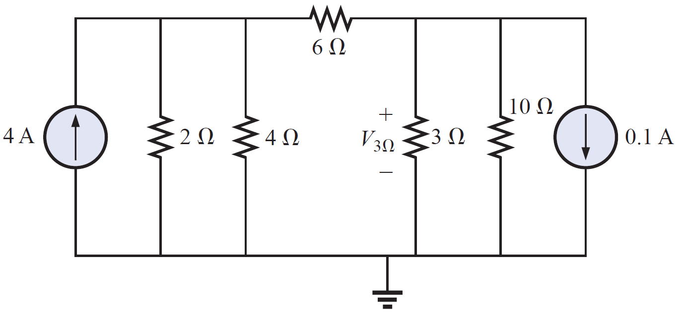
Nodal Voltage Method
EXAMPLE: By using nodal voltage method, find the voltage across the 3 Ω resistor of the circuit shown.
Solution:
Converting sources and choosing nodes, we have

Slide 15
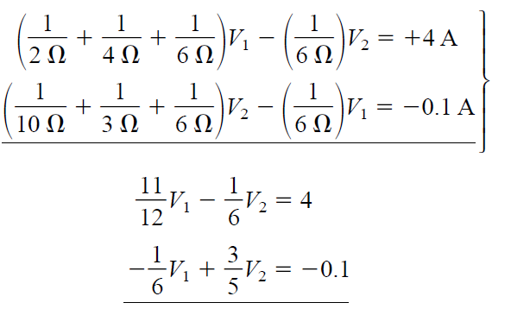
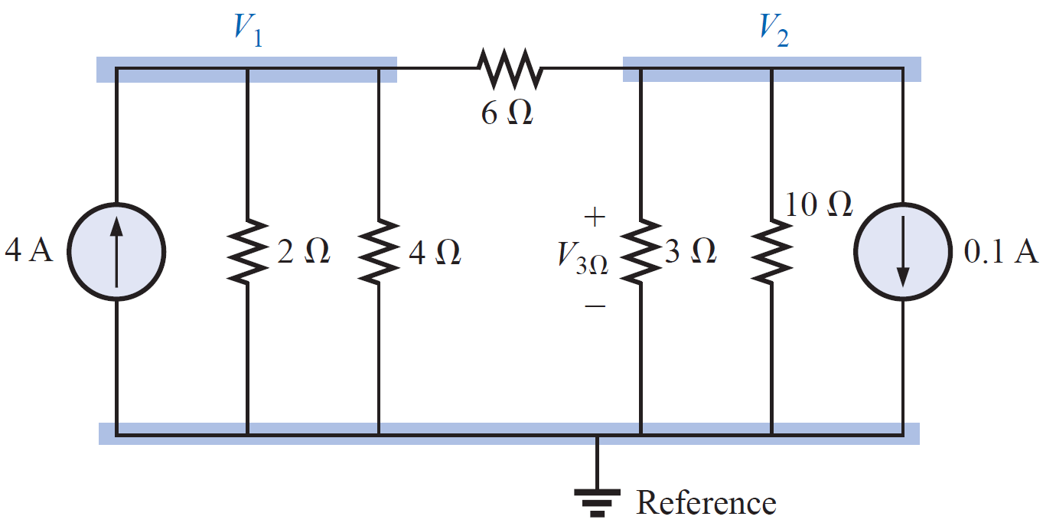
Nodal Voltage Method
EXAMPLE: By using nodal voltage method, find the voltage across the 3 Ω resistor of the circuit shown.
Solution:
Converting sources and choosing nodes, we have
Resulting in

Slide 16
Nodal Voltage Method
EXAMPLE: By using nodal voltage method, find the voltage across the 3 Ω resistor of the circuit shown.
Solution:
Solve the resulting equations to obtain the unknown node voltages.
$$∆ =\left|\begin{matrix}+11 & −2 \\ −5 & +18\end{matrix}\right|=\left(11)(18\right)−\left(−2\right)\left(−5\right)=198−10=+188$$
$$∆2=\left|\begin{matrix}+11 & +48 \\ −5 & −3\end{matrix}\right|=\left(11)(−3\right)−\left(48\right)\left(−5\right)=−33+240=+207$$
$$V_{3Ω}=V_{2}=\frac{∆2}{∆}=\frac{+207}{+188}=−1.101 V$$

Slide 17
Nodal Analysis with Voltage Sources
Special cases
CASE 1 If a voltage source is connected between the reference node and a nonreference node, we simply set the voltage at the nonreference node equal to the voltage of the voltage source.

Slide 18
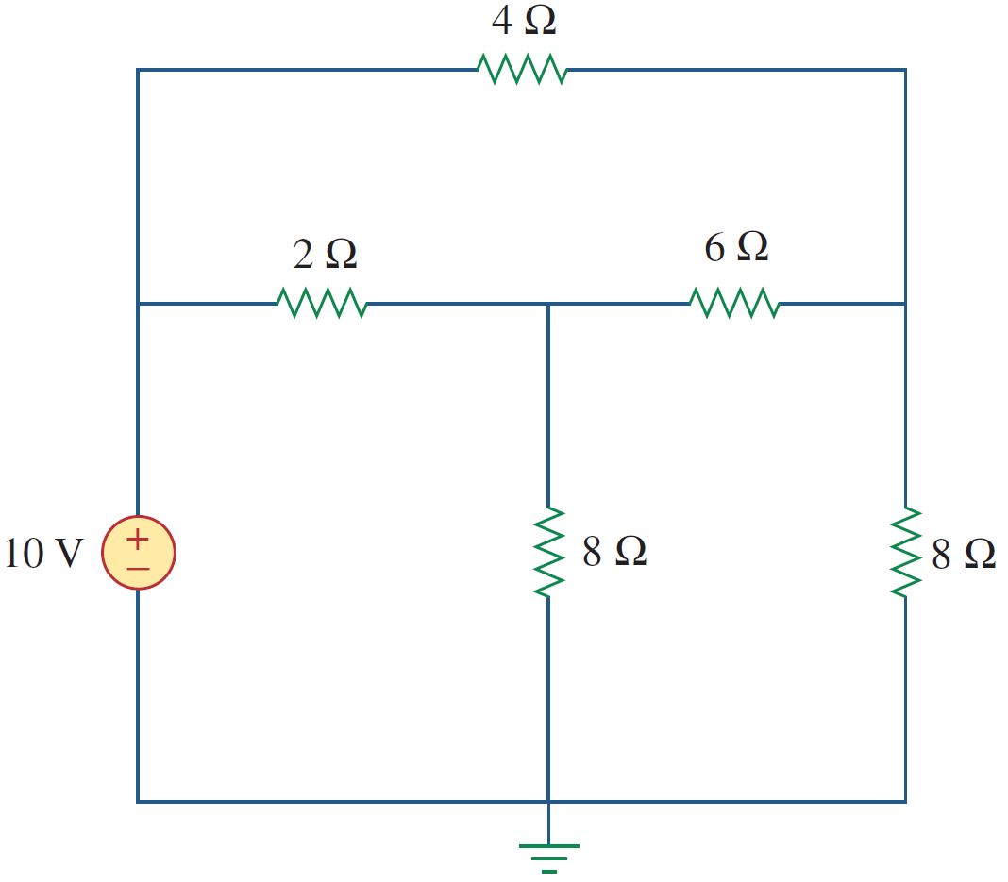
Nodal Analysis with Voltage Sources
Special cases
CASE 1 If a voltage source is connected between the reference node and a nonreference node, we simply set the voltage at the nonreference node equal to the voltage of the voltage source.
In Figure shown, for example,

Slide 19
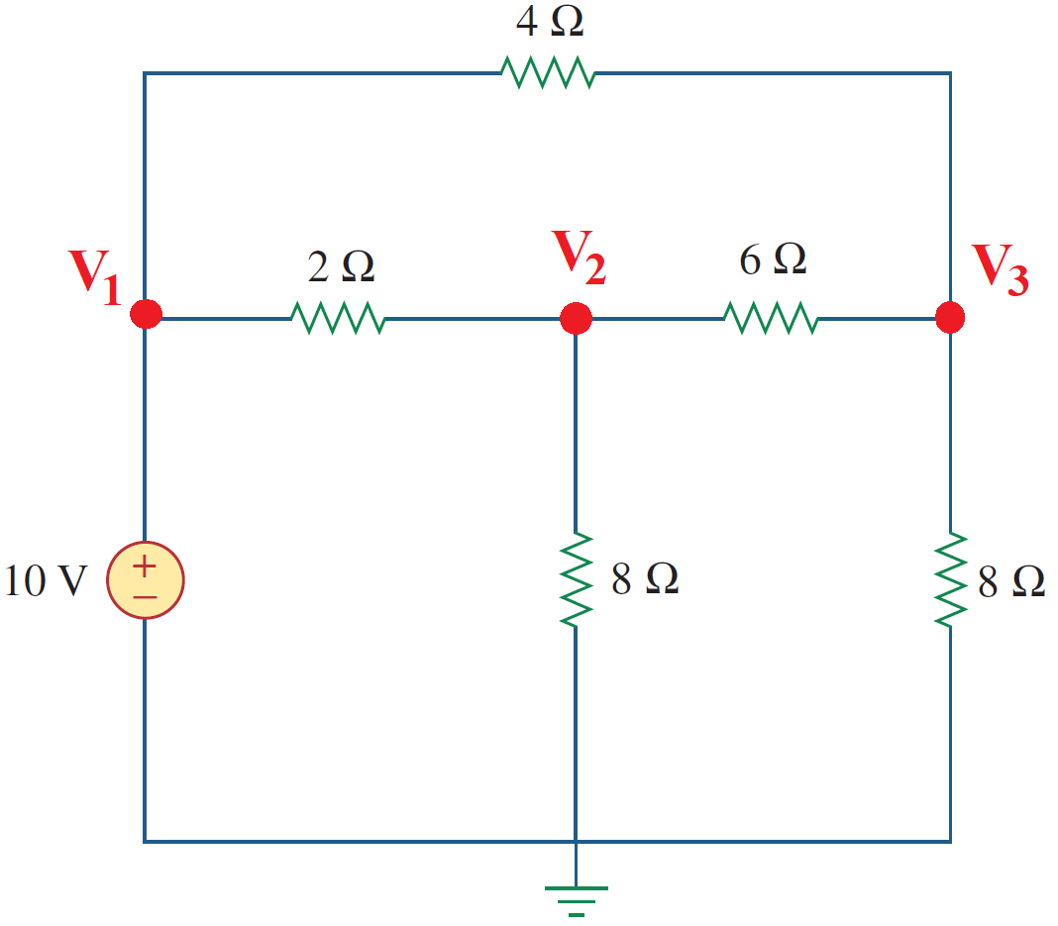
Nodal Analysis with Voltage Sources
Special cases
CASE 1 If a voltage source is connected between the reference node and a nonreference node, we simply set the voltage at the nonreference node equal to the voltage of the voltage source.
In Figure shown, for example,
In this circuit, we have 3 node voltages:
$${ V}_{1} ,V_{2}, and V_{3}$$

Slide 20
Nodal Analysis with Voltage Sources
Special cases
CASE 1 If a voltage source is connected between the reference node and a nonreference node, we simply set the voltage at the nonreference node equal to the voltage of the voltage source.
In Figure shown, for example,
In this circuit, we have 3 node voltages:
$${ V}_{1} ,V_{2}, and V_{3}$$
$${but V}_{1}=10 V$$
Thus, our analysis is somewhat simplified by this knowledge of the voltage at this node.

Slide 21
References
Boylestad, Robert L. Introductory circuit analysis. Pearson Education, 2010.
Robbins, Allan H., and Wilhelm C. Miller. Circuit analysis: Theory and practice. Cengage Learning, 2012.
Sadiku, Matthew NO, and Chales K. Alexander. Fundamentals of electric circuits. McGraw-Hill Higher Education, 2007.

